Slide 1
Design a mobile app for CPR training
Anagha Manoj

Slide 2
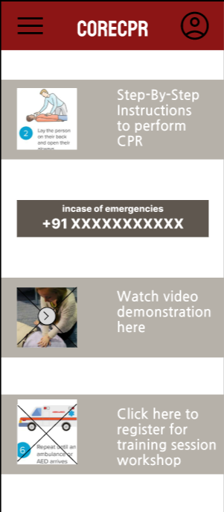
Project overview
The product:
CoreCPR is an app for training and educating all about CPR . CoreCPR strives to make first aid and CPR information accessible and affordable.
Preview of selected polished designs.
Project duration:
July 2022 - August 2022

Slide 3
Project overview
The problem:
Working professionals, students and all others need to have access to basic training like first aid and CPR. We strive to give that through our app. We allow users to easily access articles, video demonstrations, emergency calls to hospitals incase of emergency and a means to register for online training sessions so that they get necessary information even though their schedules are busy and tiring.
The goal:
Design an app that provides information about CPR that allows users to learn how to perform CPR and allows them to register for CPR training sessions in nearby centers

Slide 4
Project overview
My role:
UX designer designing an app for CoreCPR from conception to delivery.
Responsibilities:
Conducting interviews, paper and digital wireframing, low and high-fidelity prototyping, conducting usability studies, accounting for accessibility and iterating on designs.

Slide 5
User research
Personas
Problem statements
User Journey
Understanding
the user

Slide 6
User research: summary
I conducted interviews and created empathy maps to understand the user I am designing for and their needs. A primary user group identified was working adults who don’t have time to attend CPR training sessions due to their schedules. Another user group identified was students or commuters who want these additional skills learned beforehand.
These user groups confirmed the initial assumptions about CoreCPR customers, but research also revealed that time was not the only factor limiting users. Other user problems included obligation, interests, or challenges that make it difficult to go in- person for registering, searching and attending the workshop.

Slide 7
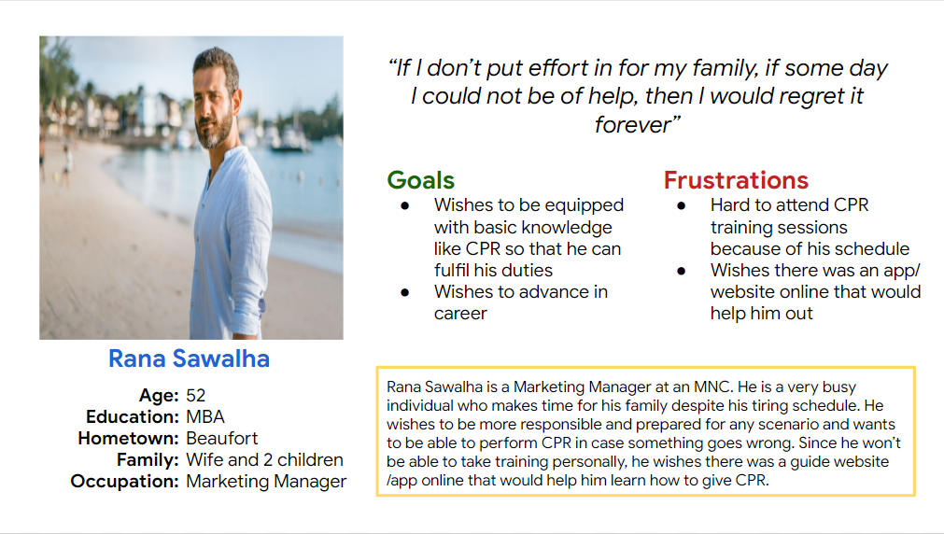
Persona 1: Rana Sawalha
Problem statement:
Rana Sawalha is a marketing manager at an MNC who needs to be able to register and attend workshops online because he does not get much time off after work and spending time with his family.

Slide 8
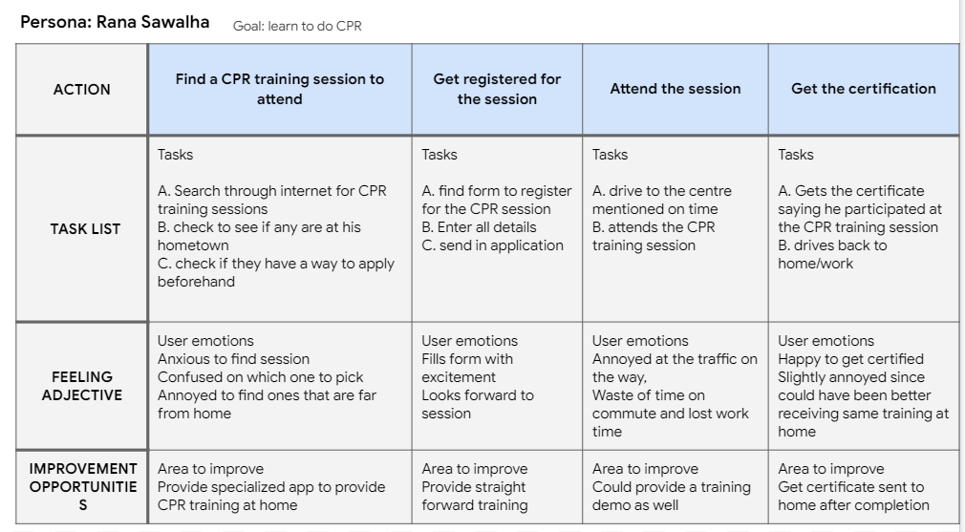
User journey map
Mapping Rana’s user journey revealed how helpful it would be for users to have access to an app like CoreCPR
Image of user journey map

Slide 9
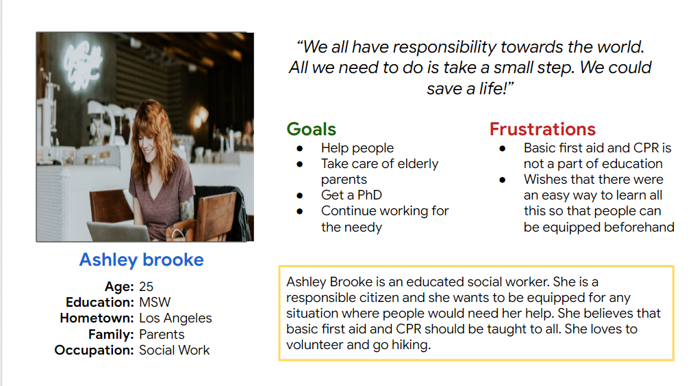
Persona 2: Ashley Brooke
Problem statement:
Ashley Brooke is a social worker who needs a way to impart basic knowledge about first aid and CPR to all because she believes it’s essential to all.

Slide 10
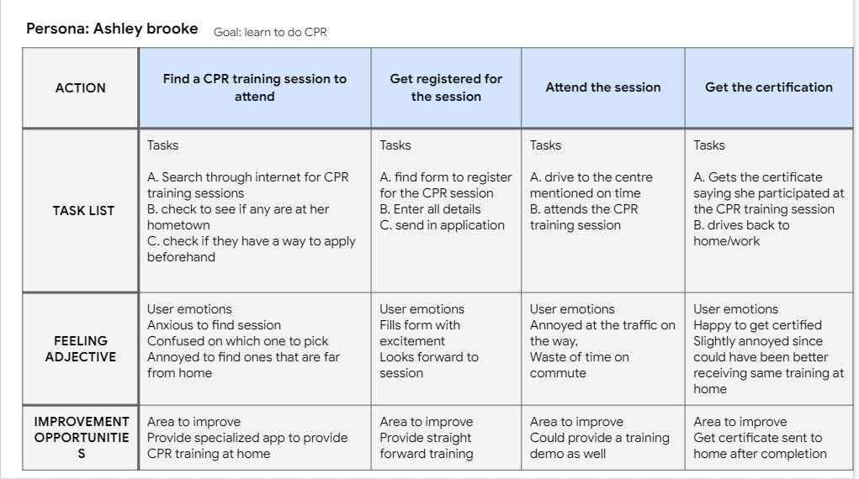
User journey map
Mapping Ashley’s user journey revealed how helpful it would be for users to have access to an app like CoreCPR
Image of user journey map

Slide 11
Digital wireframes
Low-fidelity prototype
Usability studies
Starting
the design

Slide 12
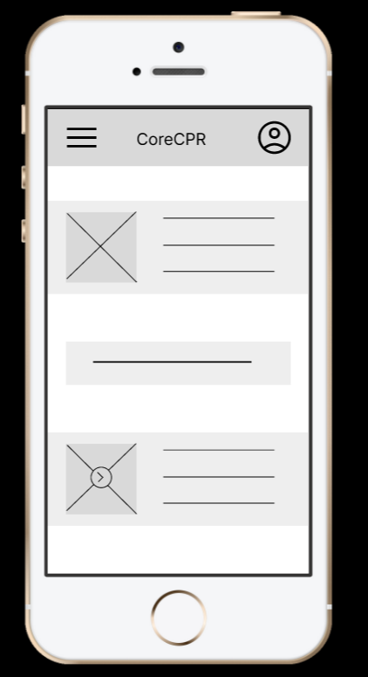
Digital wireframes
Digital wireframes
Relevant articles and demonstration are included in the homepage itself for ease of use
As the initial design phase continued, I made sure to base screen designs on feedback and findings from the user research.
Insert first wireframe example that demonstrates design thinking aligned with user research
number in case of emergencies also listed in the homepage

Slide 13
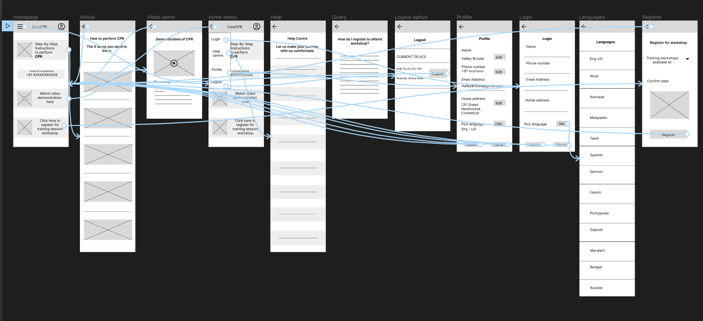
Low-fidelity prototype
The low fidelity prototype connected the primary user flow of ordering, so the prototype could be used in a usability study with users.
View the CoreCPR app’s low fidelity prototype at link
Screenshot of prototype with connections or prototype GIF

Slide 14
Usability study: parameters
Study type:
Unmoderated usability study
Location:
United states,India, remote
Participants:
6 participants
Length:
30 minutes

Slide 15
Usability study: findings
Insert a one to two sentence introduction to the findings shared below.
1
2
3
Select a Language
Workshop Registration
Live Demo
Users wanted to select preferred language while signing up
Users wanted a way to register for training workshops online easily
Users wanted live demos of the CPR session to review

Slide 16
Refining
the design
Mockups
High-fidelity prototype
Accessibility

Slide 17
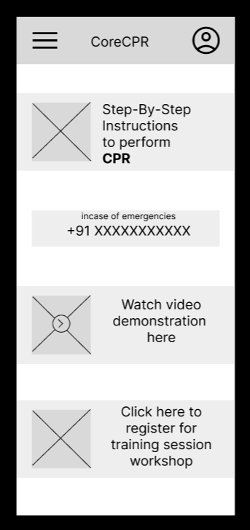
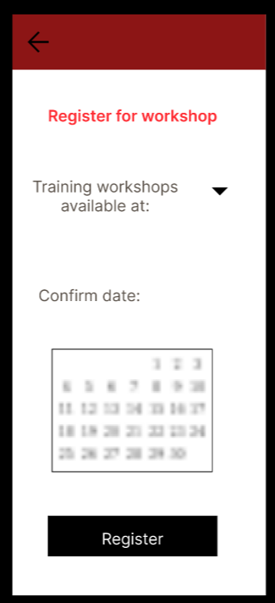
Mockups
Before usability study
After usability study
The first usability study showed frustrations regarding there being no feature for registering for workshop through app. The design was revised so that there is a quick and easy way to do so that allows you to select an area close to you that has training workshop as well as date from the calender that’s suited to you
Mockup 1 before
Mockup 1 after

Slide 18
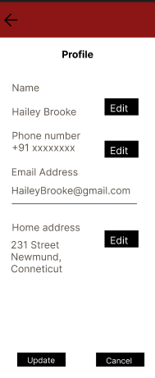
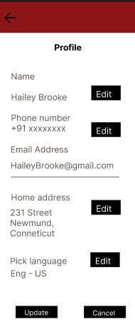
Mockups
Before usability study
After usability study
Another frustration was having no option to select languages for non native speakers. This was resolved later.
Mockup 2 before
Mockup 2 after

Slide 19
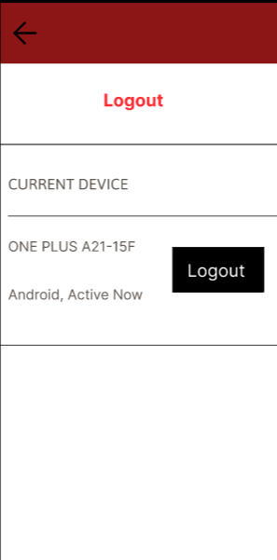
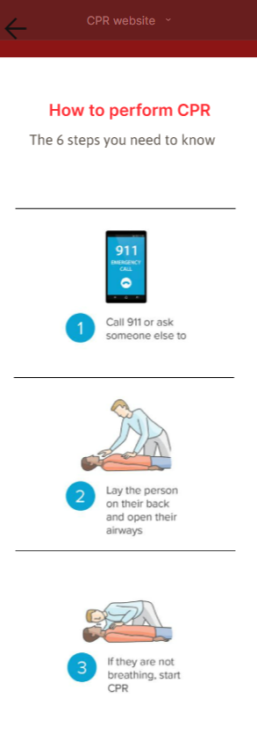
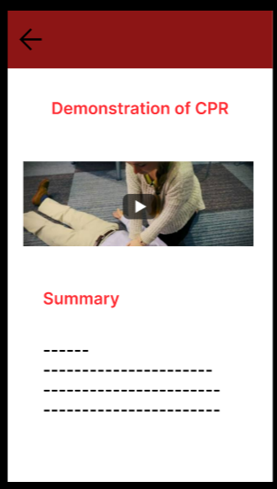
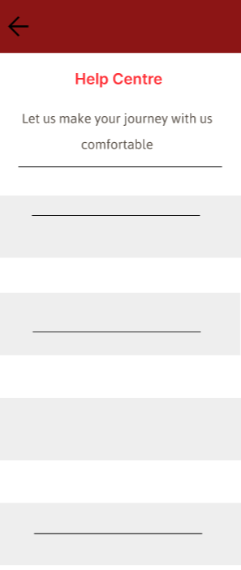
Mockups
Main mockup screen for display
Main mockup screen for display
Main mockup screen for display
Main mockup screen for display

Slide 20
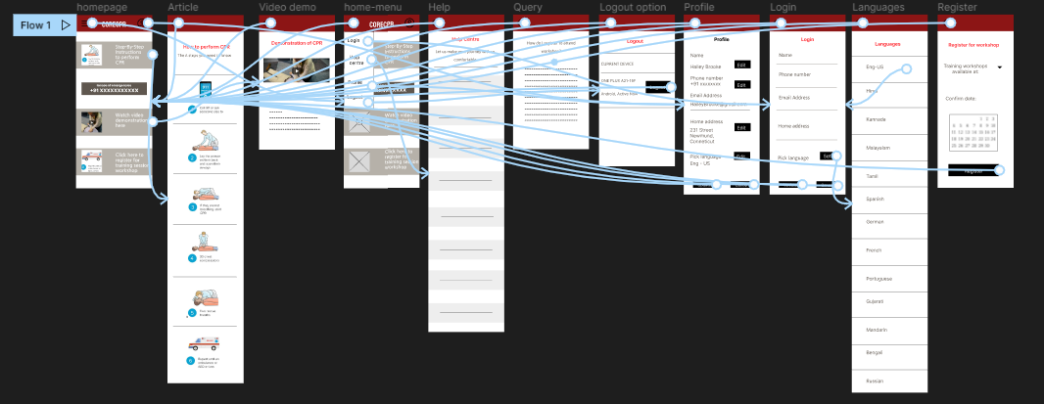
High-fidelity prototype
The final high-fidelity prototype presented cleaner user flows and satisfied user requirements.
Click to view CoreCPR’s Hi-Fi prototype at link
Screenshot of prototype with connections or prototype GIF

Slide 21
Accessibility considerations
1
2
3
Provided access to users who are visually impaired through adding alt texts to images for screen readers.
Used icons to help make navigation easier.
Consistent designs through all the different screen sizes to facilitate easy understanding

Slide 22
Responsive Design
Information architecture
Responsive design

Slide 23
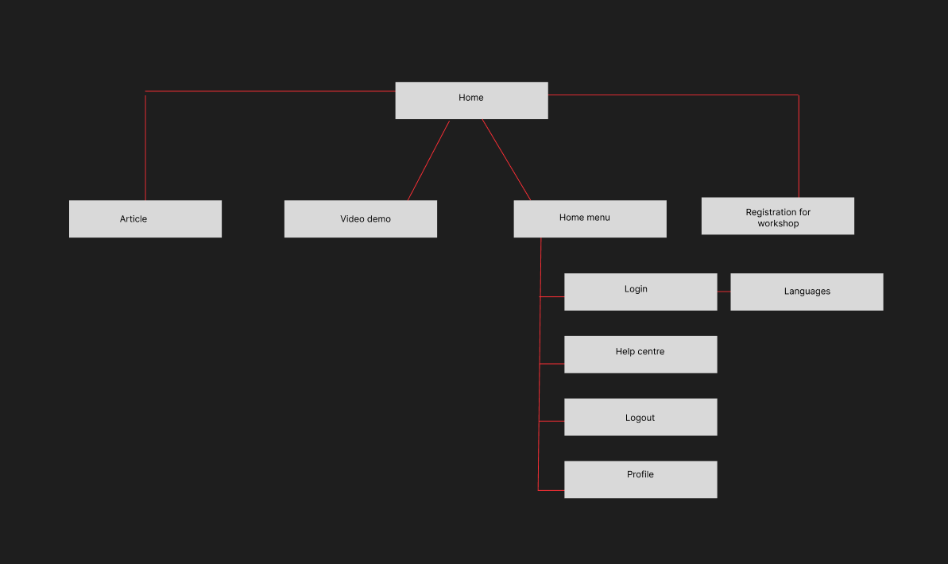
Sitemap
This is a layout of the sitemap for the app - CoreCPR
Image of sitemap/IA

Slide 24
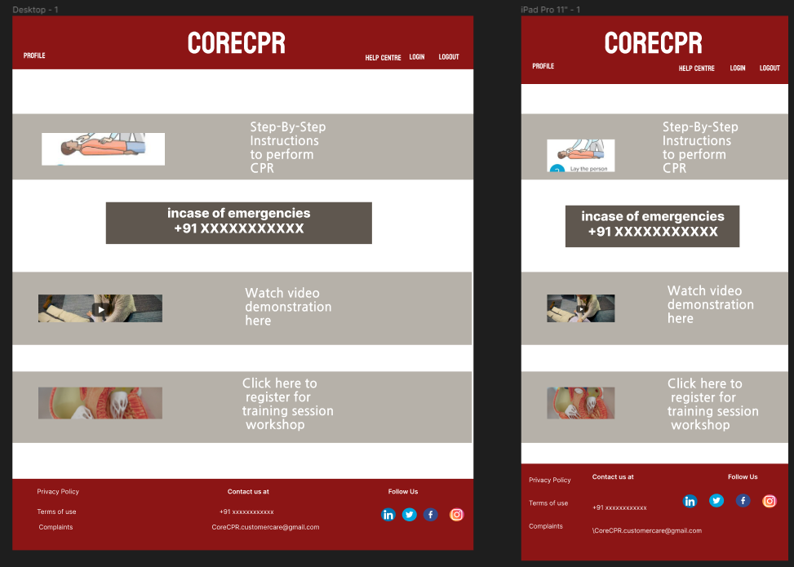
Responsive designs
I wanted to make sure the design was consistent in all the different screen sizes to make the navigation easier for users and make it more familiar to users.
Images of each screen size variation

Slide 25
Going forward
Takeaways
Next steps

Slide 26
Takeaways
Impact:
The app makes users feel like CoreCPR really thinks about how to meet their needs and is trying to make their lives easier.
What I learned:
While designing the CoreCPR app, I learned that the first ideas for the app are only the beginning of the process. Usability studies and peer feedback influenced each iteration of the app’s designs.

Slide 27
Next steps
1
2
3
Conduct another round of usability studies to validate whether the pain points users experienced have been effectively addressed.
Conduct more user research to determine any new areas of need.
Add features that help users buy first aid through this app and provides legitimate online course/ training that certifies users.

Slide 28
Let’s connect!
Thank you for your time reviewing my work on the CoreCPR app! If you’d like to see more or get in touch, my contact information is below.
Email: anaghasobhamanoj@gmail.com
Linkedin: https://www.linkedin.com/in/anagha-manoj49

